Slide 1

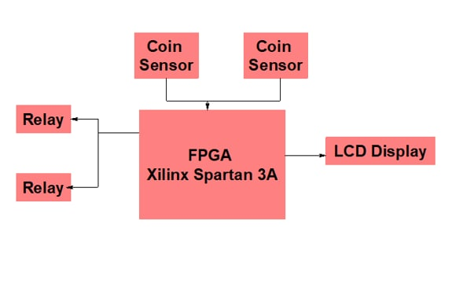
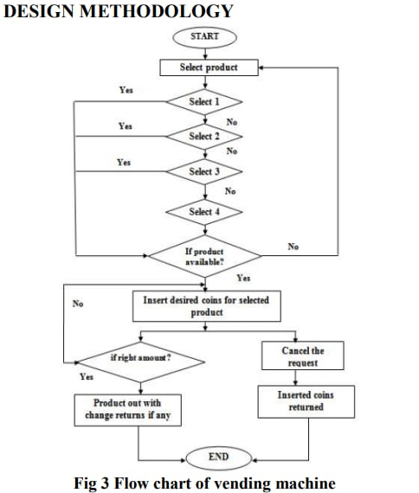
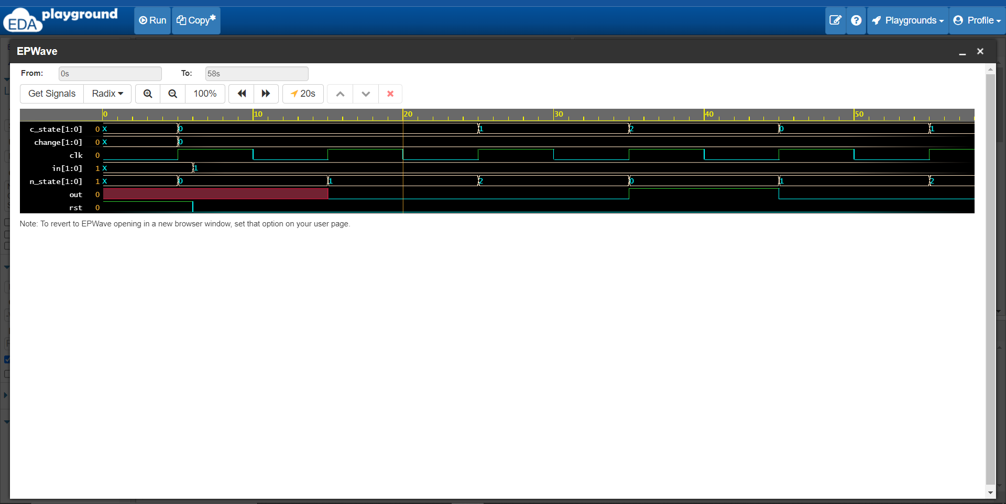
A VLSI Implementation Vending Machine Based on Verilog
MD.IBRAHIM (2000040232) AABDHUL KAMOUR (2000040260)
Dr ARAVINDHAN ALAGARSAMY, Professor,
Department of ECE
Introduction
BLOCK DIAGRAM
Improvements
An automated machine which is intended to provide the users with a diverse range of products: snacks, beverages, pizzas, cupcakes, newspapers, tickets, etc. A vending machine dispenses a product to the users based on the amount of money inserted and selection of the product. Vending machine is a 24x7 standalone unit which requires a standard power supply connection to function. It consist of simple electro-mechanical systems which helps to automate the entire vending process.
Sophisticated automated system : A two-axis robot which would help to pick and place the selected snack in the dispense chute. The robotic arm will eliminate the possibility of snack getting stuck in the machine and snack inducing damage due to the free fall in the dispense chute.
Interactive displays : Instead of having traditional glass displays, large digital LED touchscreen displays would help to attract user attention. This large display will help to keep users engaged by presenting users with additional product information (like ingredients and calorie content), news feeds, gaming, and social networking updates.
ntegrated sensors : Sensors would enable use of various payment technologies like credit/debit cards, mobile payments, QR code billing etc. These payment options will not constraint the users from using the vending machine if they do not have cash on hand. Additional sensors would also help to track user behavior and recommend rotation of snacks based on demographics.
.
Methods
J
Refernces
To Design a powerful vending machine containing
the following features:
1. Sell four different types of snacks and accept
three types of coins(Rs1, Rs2, Rs5)
2. Give change after successful trade
3. Return money when trade fails
4. Small size and acceptable power consumption
5. If cancel button is enter, amount will return
References and Affiliations
OUTPUT
References
sThe refrences [1] Sumi M, Ebrahim A. Soujeri, Rahim Rajan, Harikrishnan A. I, “Design of a zigbee-based RFID network for industry applications”, proceedings of the 2nd international conference on Security of information and networks, 2009, pp. 111-116..
[2] Satoshi Takahashi, Jeffrey Wong, Masakazu Miyamae, Tsutomu Terada, Haruo Noma, Tomoji Toriyama, Kiyoshi Kogure, Shojiro Nishio, “A ZigBee-based sensor node for tracking people's locations”, proceedings of the 2nd ACM international conference on Contextawareness for selfmanaging systems, 2008, pp. 34-38.
Acknowledgements
Ahe authors would like to thank the anonymous reviewers for their comments which were very helpful in improving the quality and presentation of this paper.

